Slide 1
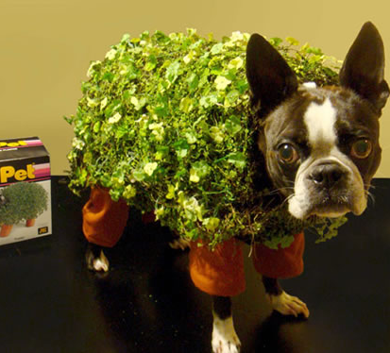
Thursday, January 12, 2023
Bring your habitat plate to your seat.
The chia pets have been soaking in water to prepare to take the seeds. We will get them by table once class has started.
This Photo by Unknown Author is licensed under CC BY-SA-NC

Slide 2

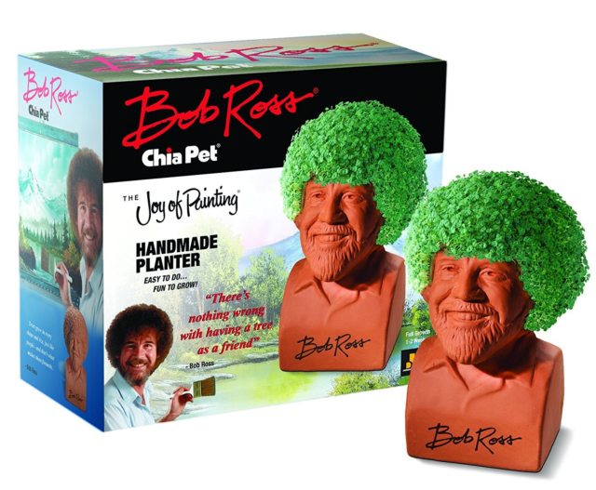
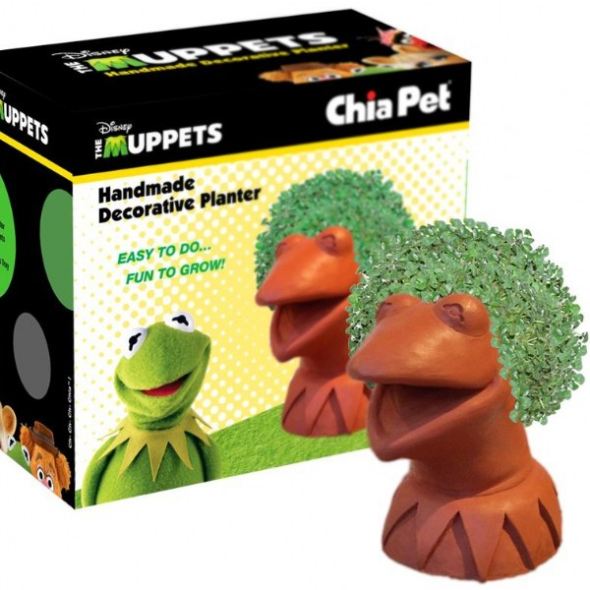
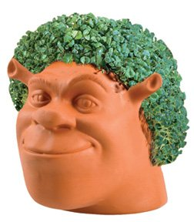
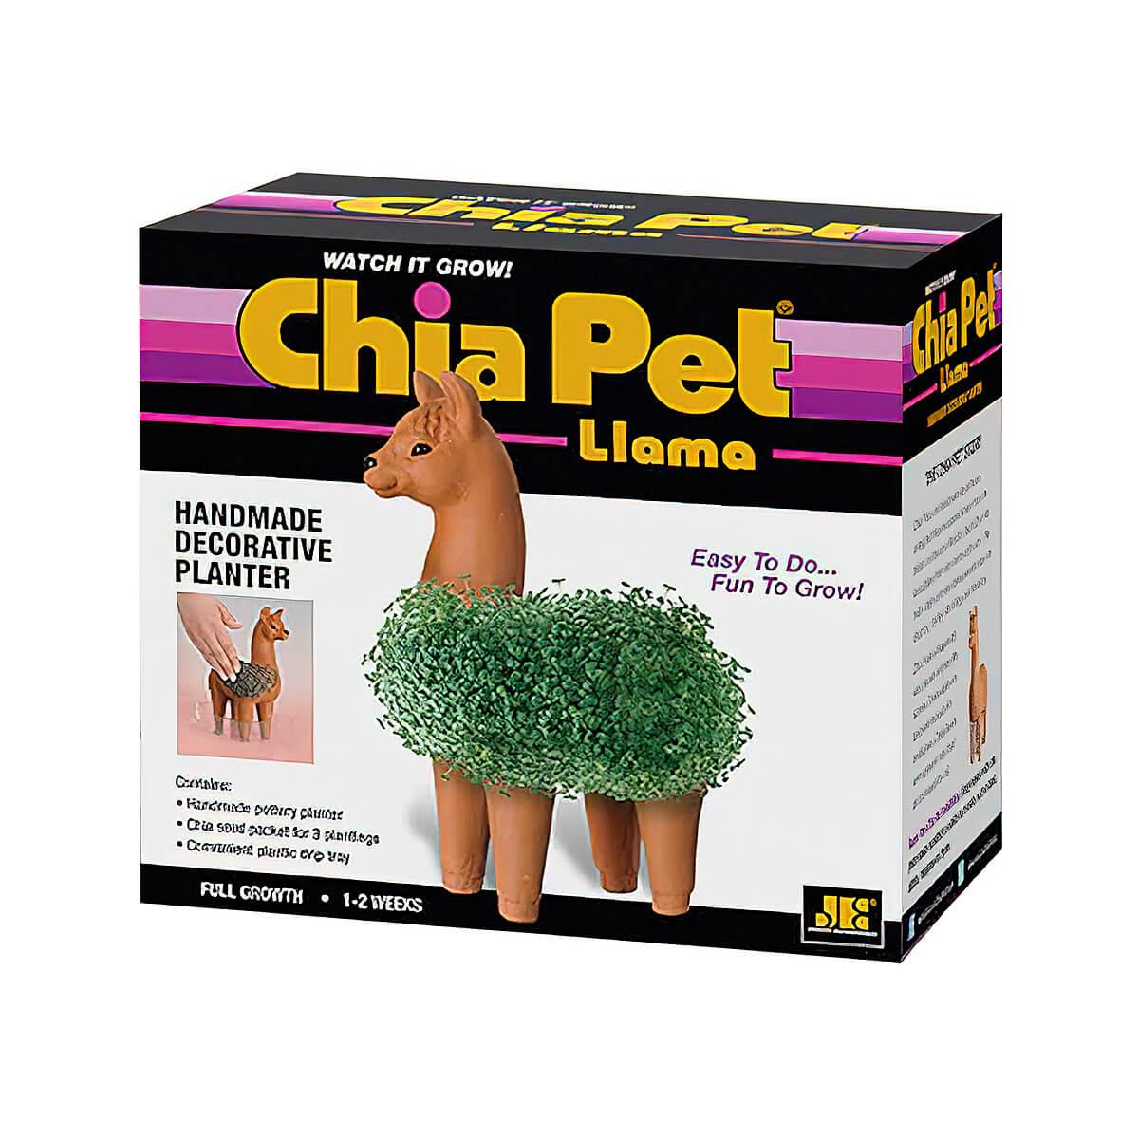

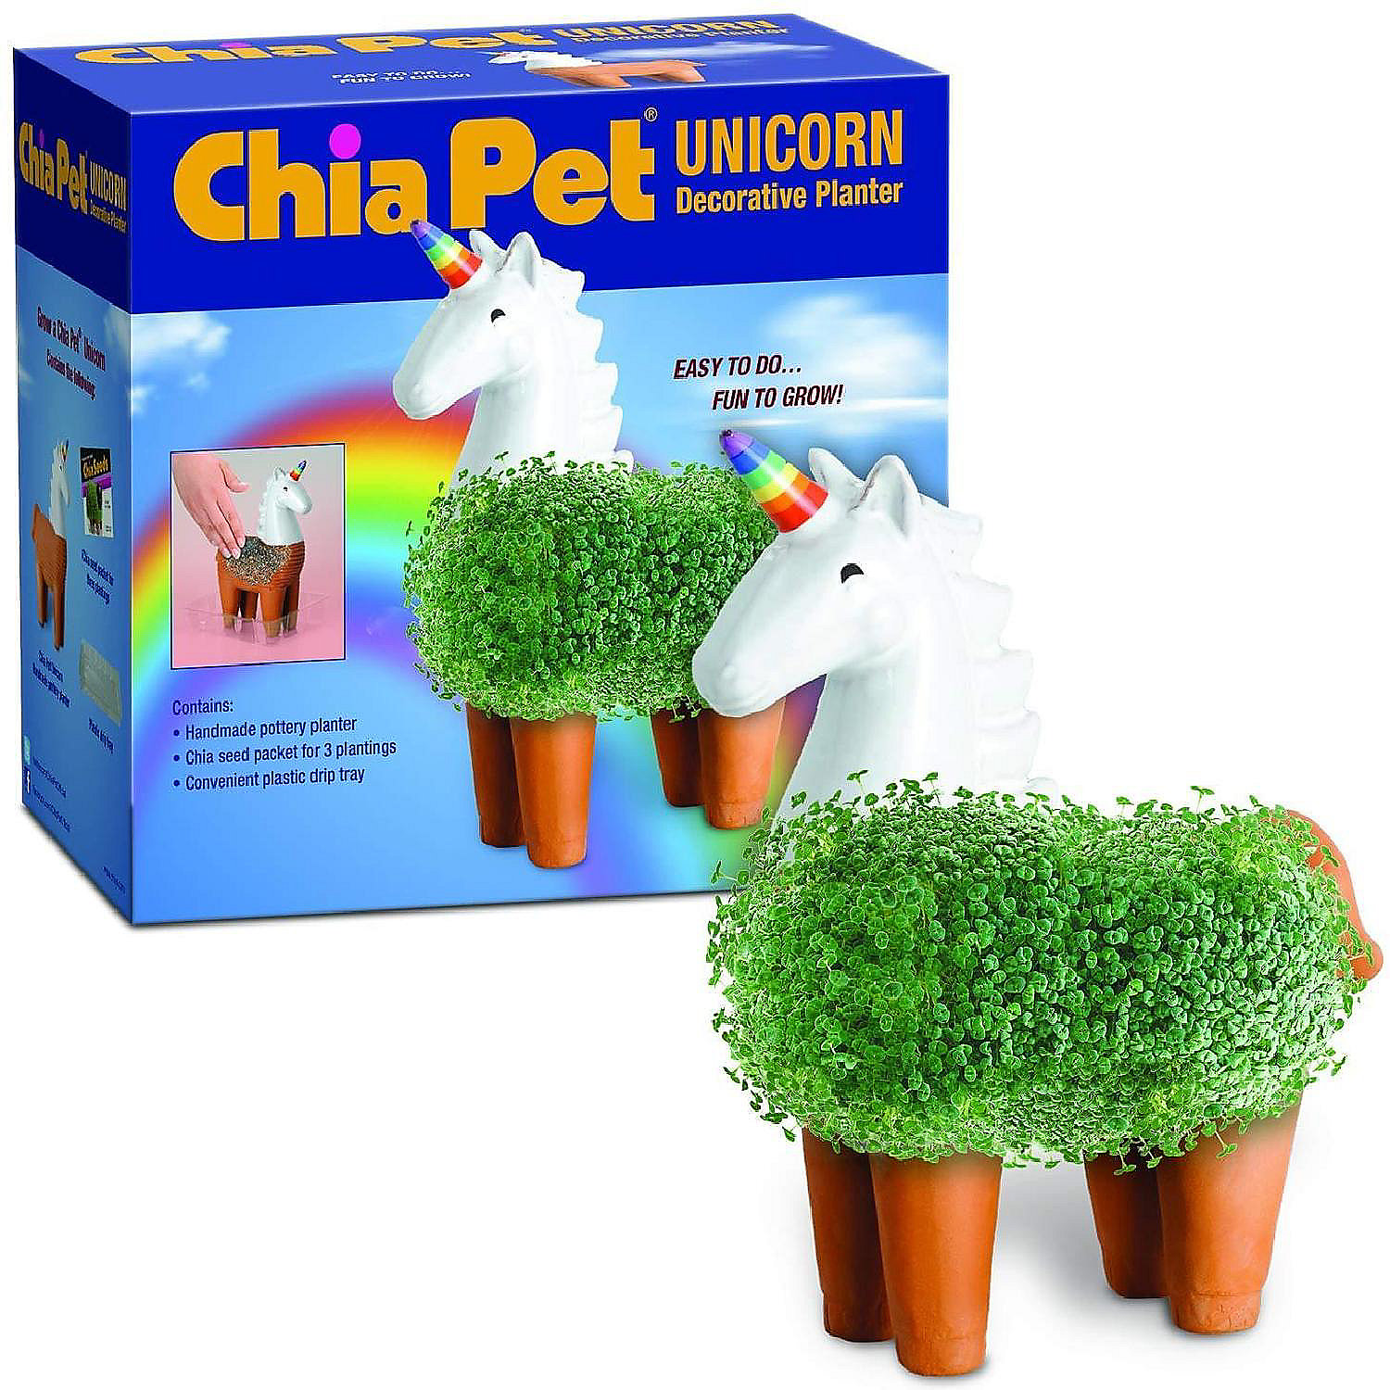
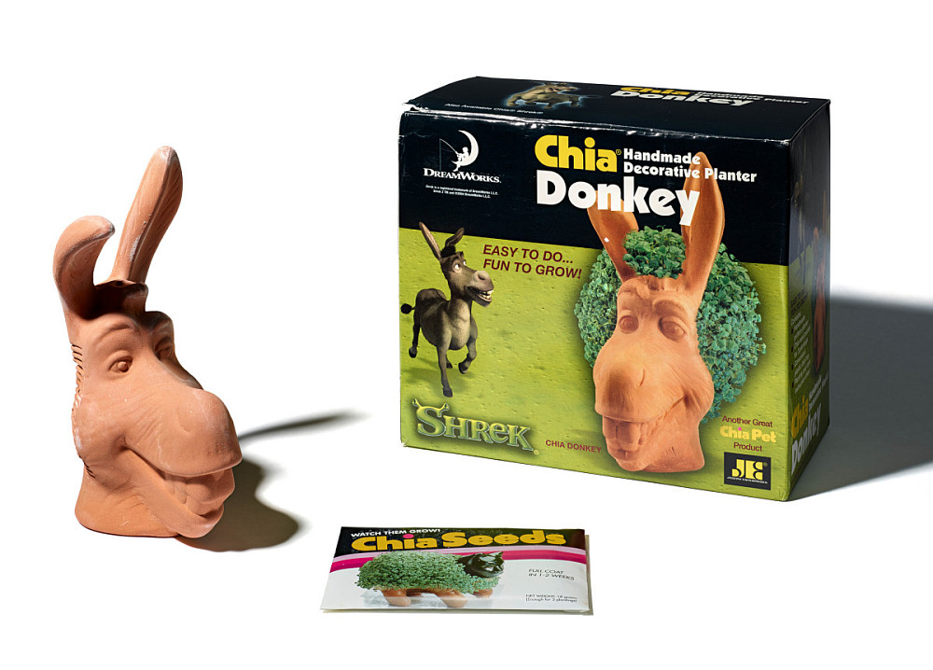

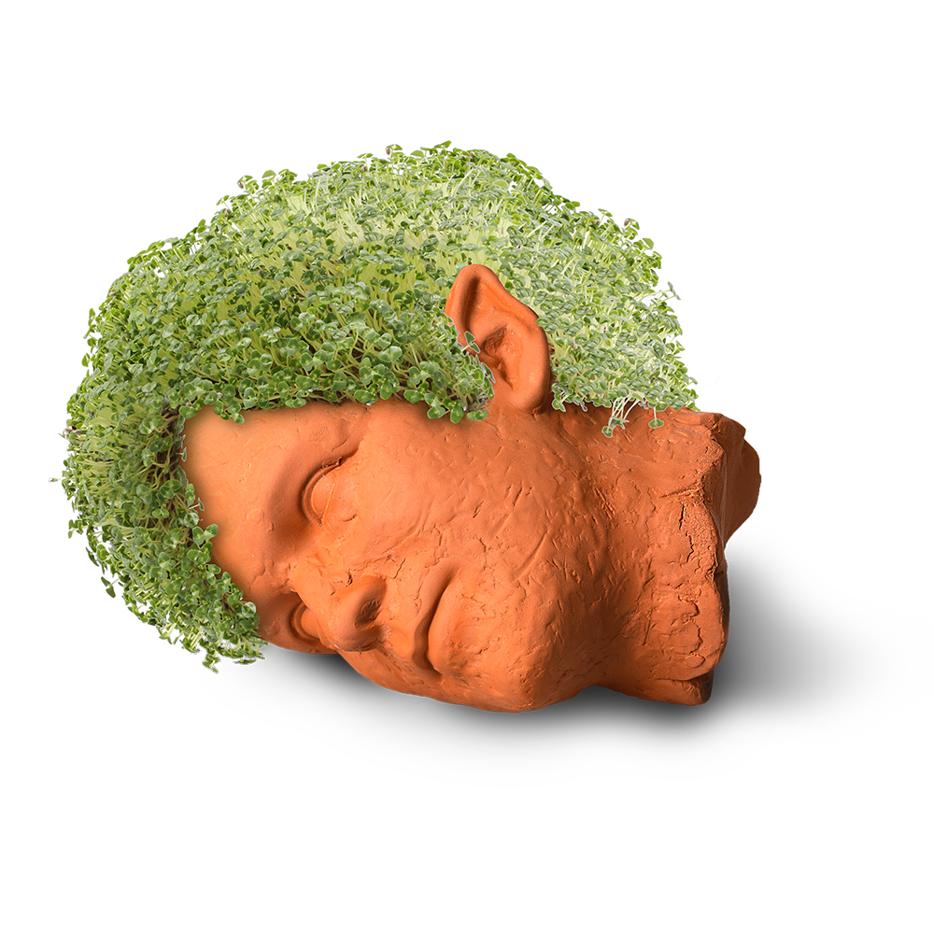
Chia Pets
1 2 3 4
5 6 7 8
9 10
Ch Ch Ch Chia

Slide 3
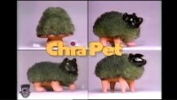
Chia Commercial

Slide 4
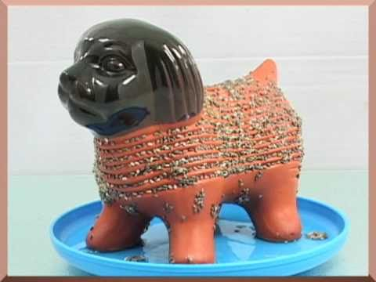
Anatomy of a Chia Pet
Water Hole
Hollow “bowl” for water
Grooves for Seeds
Water Catcher

Slide 5
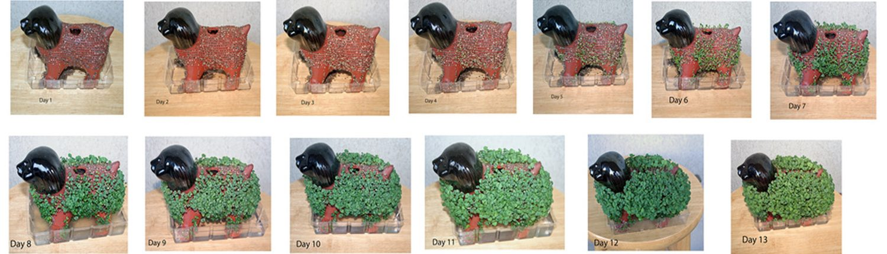

Slide 6
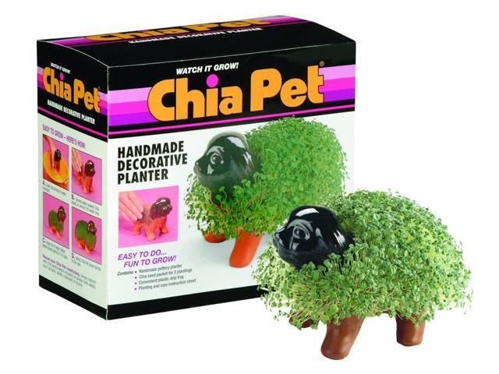

Slide 7
What has been done for us
Part 1
Starting Your Chia Pet
1. Soak your Chia pet in water for 24 hours. Take the terracotta pot out of its packaging, and put it into a bucket filled with water. The pet needs to be completely submerged. This will moisten the entire pet, and help the seeds stick to it better.
2. While the pet is soaking, put 2 teaspoons (5 grams) of Chia seeds into ¼ cup (60 milliliters) of water. This softens the seeds, and "wakes" them up. The seeds will start growing once they get wet. This will be enough for one pet. Chia pet kits often contain enough seeds for several pets.
3. Stir the seed mixture after 15 minutes with a spoon. This will help the seeds soak more evenly.[2] You don't need to stir the seeds again after this. Let the seeds soak for 24 hours. During this time, the seeds will form a gel-like coating. This will help them stick to the Chia pet.

Slide 8
You Need
Your Chia Pet and habitat
1 plastic bag
1 popsicle stick
A cup of chia per table
A larger cup of water per table
Smock (optional)

Slide 9
What do we do today?
4. Fill Chia pet all the way with water and place it in the habitat tray. Fill it with fresh water. The drip tray will catch any extra water. It will also protect your desk or windowsill from getting stained.
5. Spread the seeds evenly over the grooves in your Chia pet. You can use your fingers or the stick. Try to spread the seeds as evenly as possible; don't let them clump in any one area. If there is a hole in the top of your pet, take care to avoid it. This is where you will be pouring the water. The seeds may slide, that is okay, they are slippery and that is natural.

Slide 10
And then…
Slide your Chia Pet (still on the habitat tray) into the plastic bag. Zip the bag closed. Keep your Chia pet in the bag for the first 3 or 4 days if the air is dry. Don't let the bag touch the actual pet, however, or the seeds won't sprout. The plastic bag will help create a mini greenhouse for your Chia pet. Take the bag off after 3 to 4 days, when most of the seeds have sprouted.
Place the Chia pet on the designated cart.
Pick up your Chia Pet at the end of the day or take it with you next class.

Slide 11
Complete Performance Matters
Lunar New Year Drawing

